Slide 1

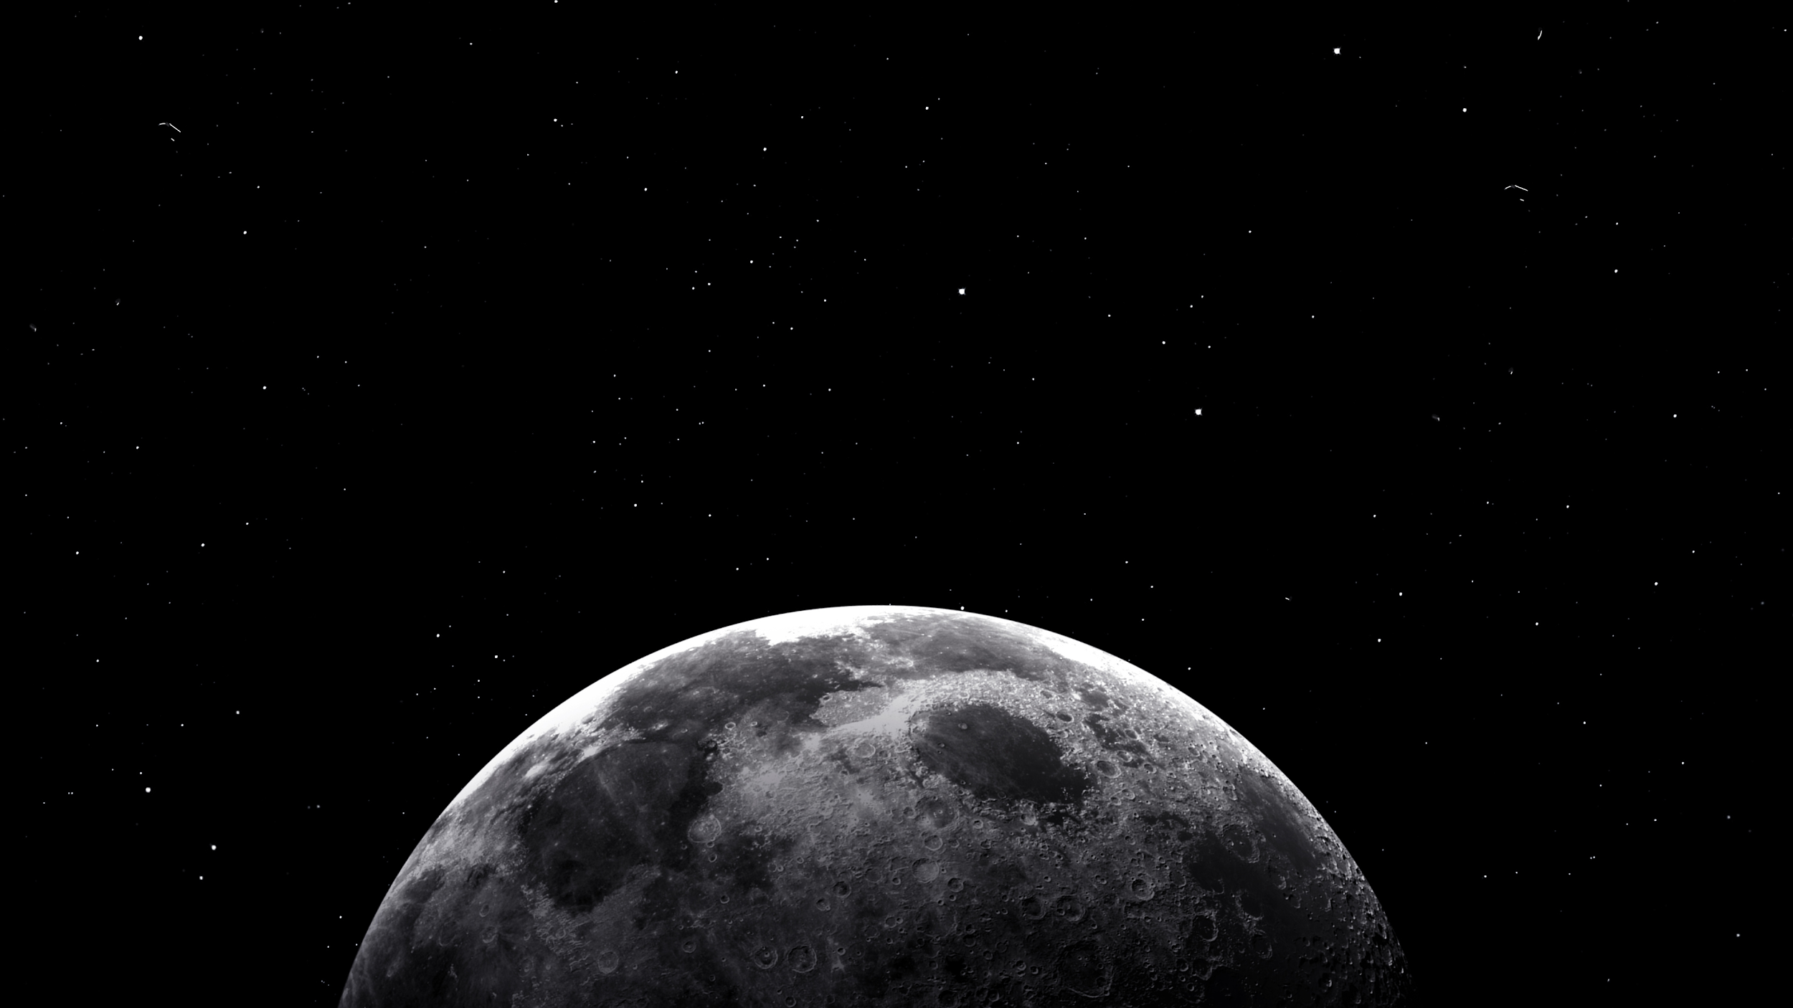



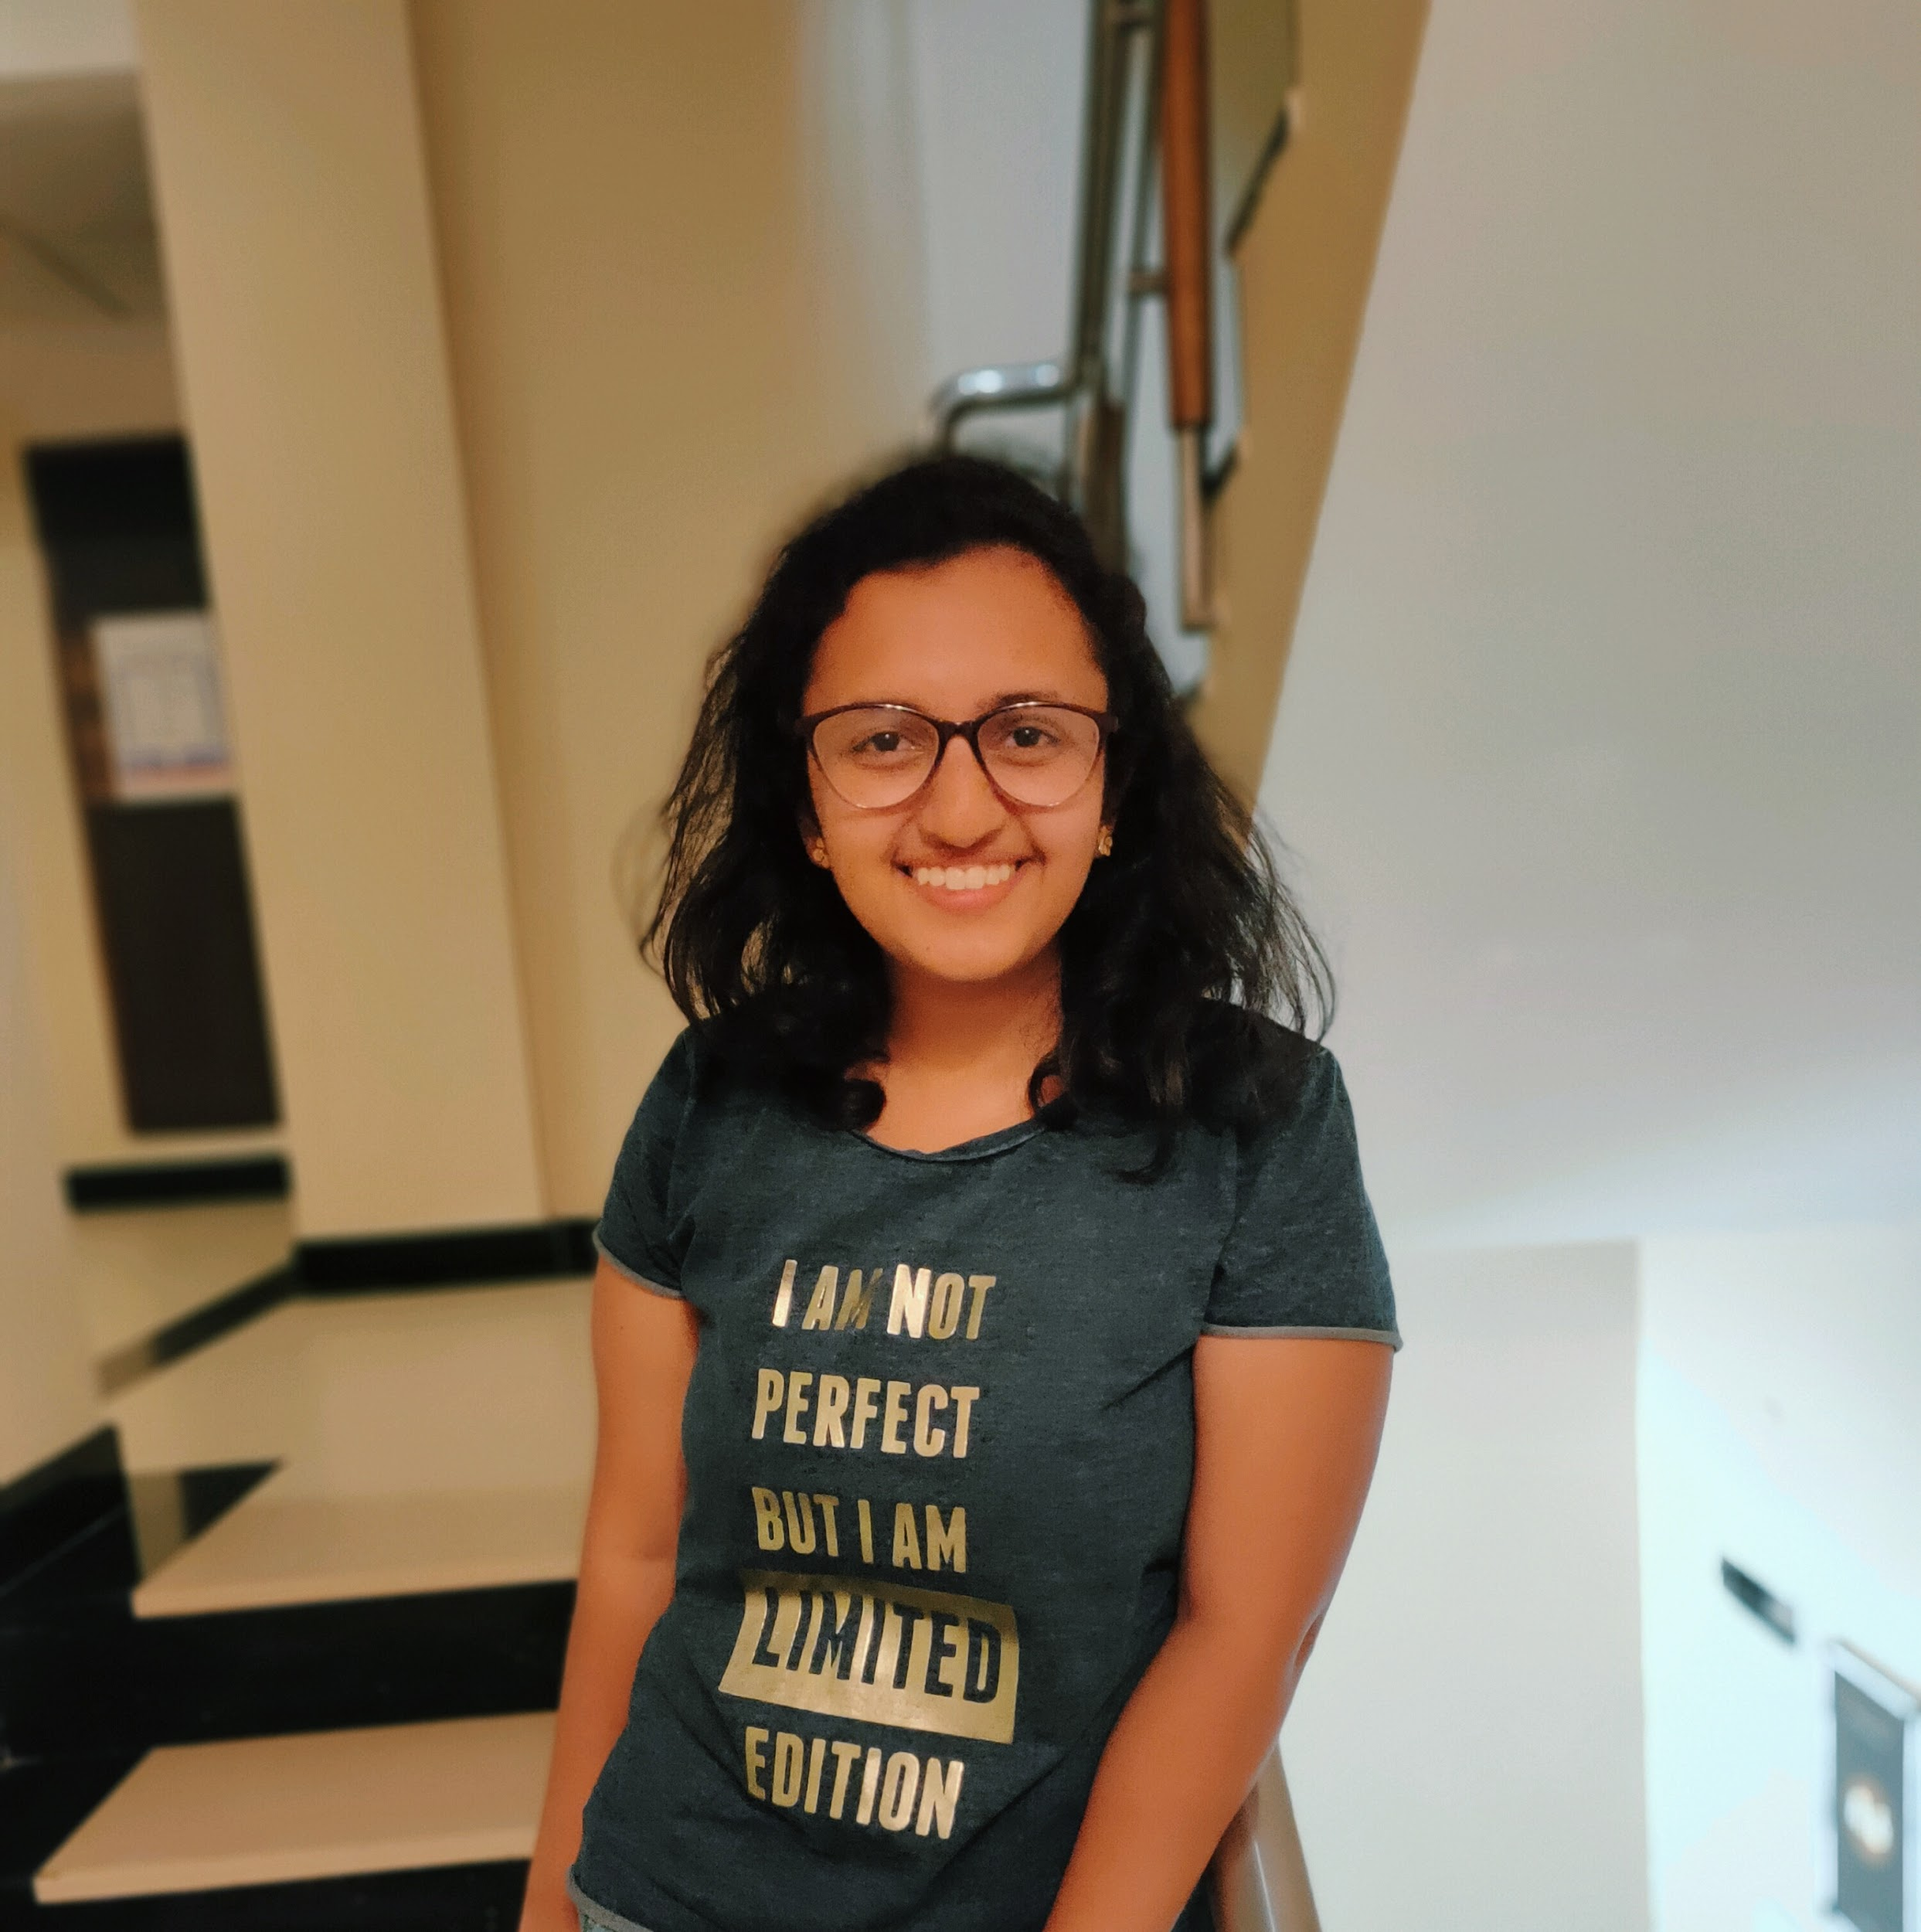


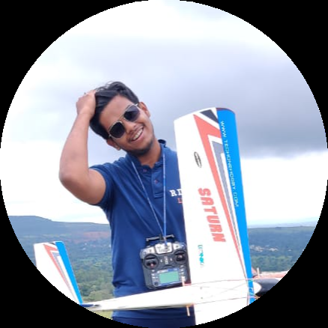

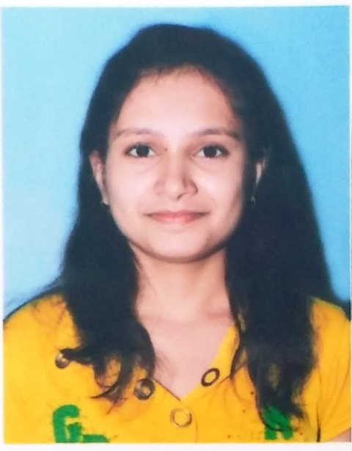




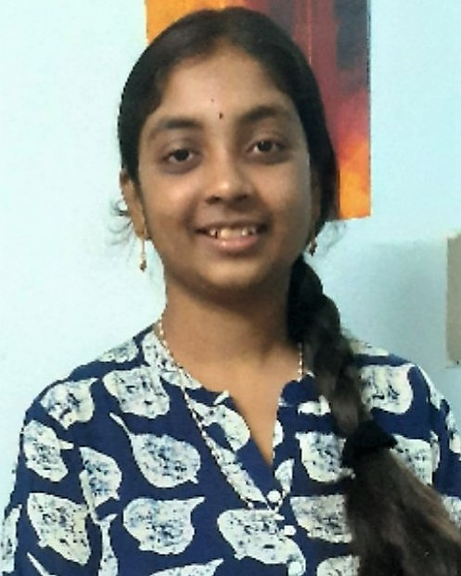
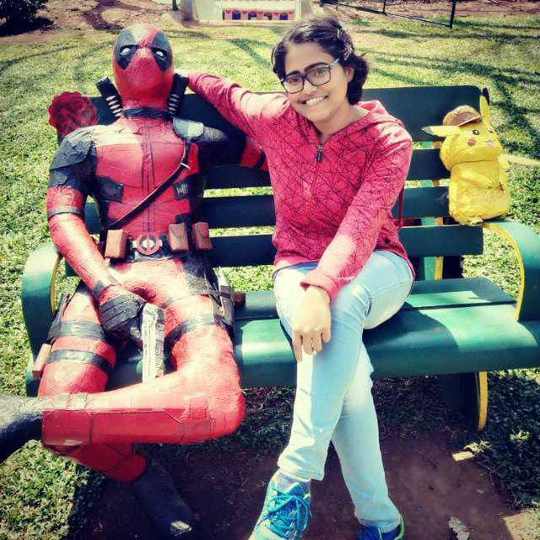


Slide 2

The Team
Osho Priya
Team Leader
(Communication Subsystem- Swarm)
Niranjan Akella
Vice Team Leader
(Communication Subsystem- WPT)

Slide 3
The Team - Soft Landing Subsystem
Ishita Bhatnagar
Prachi Singh

Slide 4
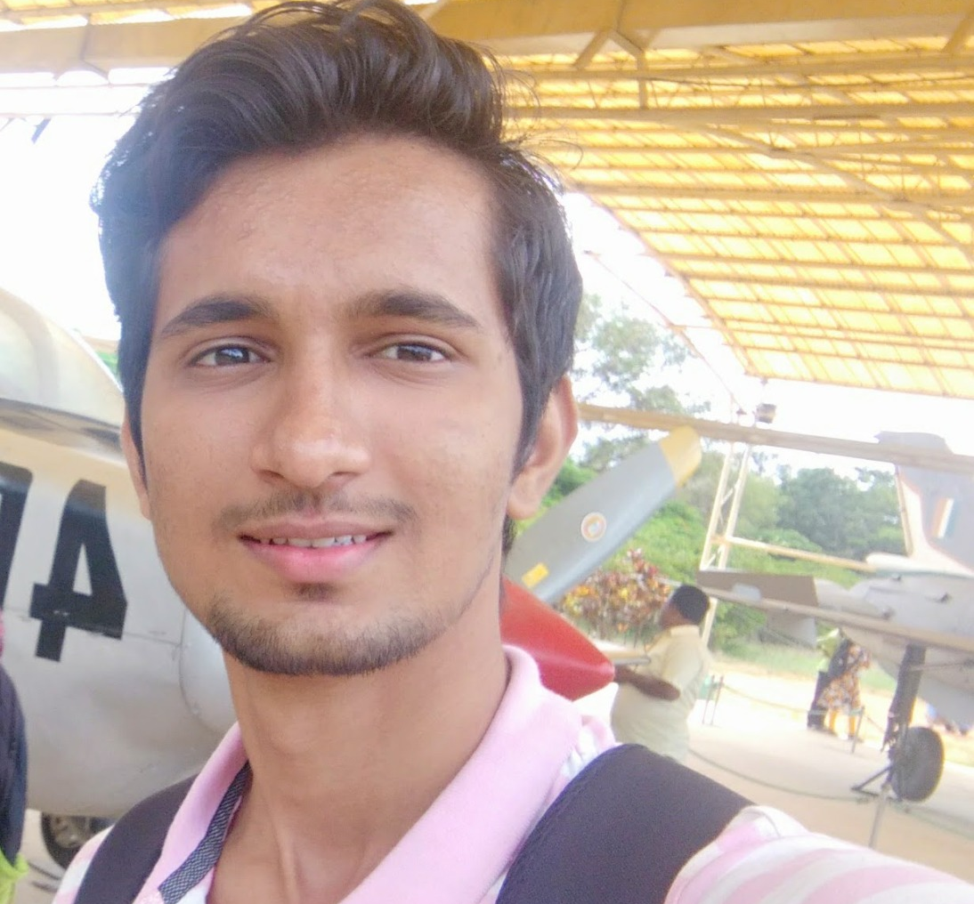
The Team - Mechanical Subsystem
Aditya Gaundalkar
Ashraf Raza
Hrushikesh Ashtekar
Abhishek Hulloli
Arundhati Paramshetti
Ananya Kapoor
Darshan Jadhav

Slide 5
The Team - Communication Subsystem
Srinivas T B
(Computing)
Sasirekha Gangavarapu
(WPT)
Asvanth K.
(Swarm Communication)
Siddhaanth Iyer
(Computing)
Aiswarya Sivaprasad
(WPT)

Slide 6

Mission, Vision, and Objectives
Design and build next generation rovers for Lunar Exploration.
Help establish a city on CHAAND.
Establish a lunar communication network with the help of swarm robotics. As the rovers disperse away from the queen, they drop repeaters at intervals to amplify communication signals and keep communicating with the queen and other mini rovers.
Wireless powering of the rover to carry out its functionalities.
Ensure soft landing of the rover.
Create a robust chassis which ensures safe traversal of the lunar terrain.
Build compute models to help in navigation and terrain-mapping.
Find perfect site for excavation of lunar regolith and minerals.

Slide 7
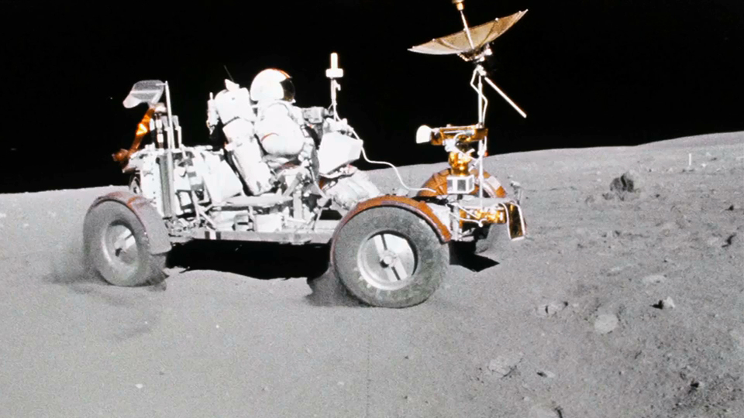
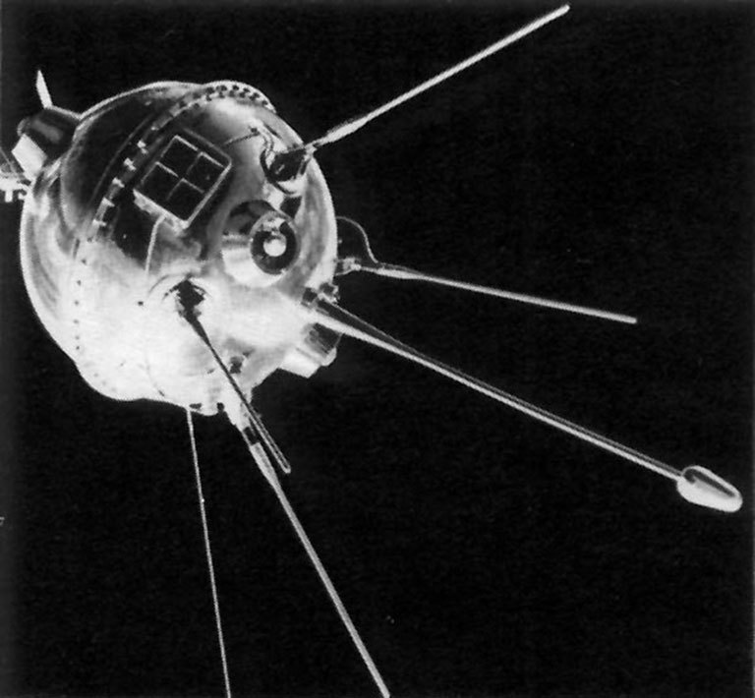
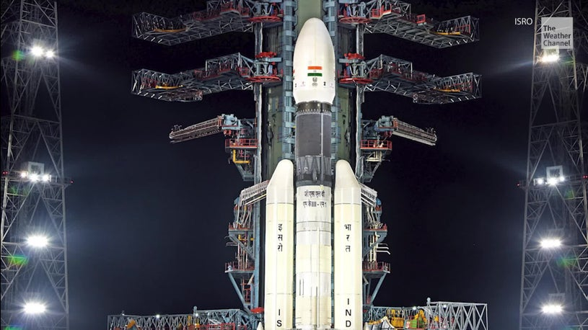
Subsystem - Soft Landing
Moon Landing - Introduction & History

Slide 8
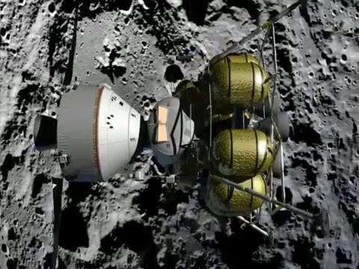
Subsystem - Soft Landing
Soft Landing & Fuel Optimization

Slide 9
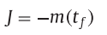
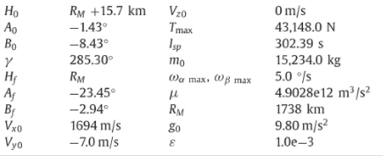
Subsystem - Soft Landing
Problem Solving
Problem Statement
Fuel optimal trajectory optimization for soft landing of the rover on the lunar surface.
Assumptions
Aerodynamic forces and gravitational forces of bodies other than the Moon are negligible and lateral motion is ignored.
descent trajectory is vertical and the thrust vector is perpendicular to the ground.
Objective Function
Symbol Value
Symbol Value
Mission Information Table

Slide 10
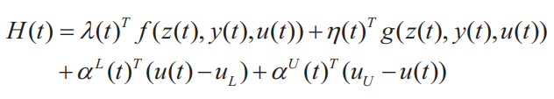
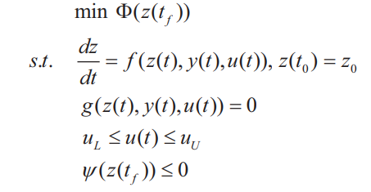
Subsystem - Soft Landing
Solution Process
Simultaneous Dynamic Optimization Approach | Adaptive mesh refinement strategy

Slide 11
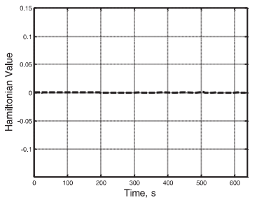
Subsystem - Soft Landing
Conclusion
We observed that the Hamiltonian profile is almost constant over time, which illustrates that the results are optimal.

Slide 12
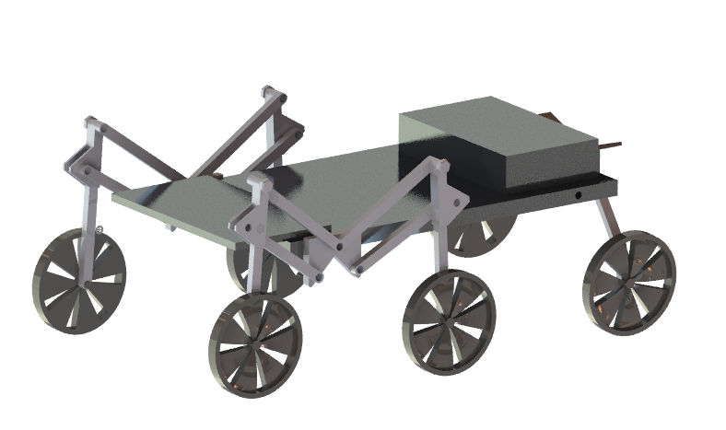
Subsystem - Mechanical (Chassis )
Objective :
To design and model a chassis for the lunar rover which is stable and has good obstacle surmounting capabilities
To also design the swarm rover and a mechanism to deploy them from the mother rover
The chassis of the rover should be designed keeping in mind the following points
Stability of the main body of the rover
Obstacle climbing capacity
Provide even weight distribution
Pic credits : Aditya G

Slide 13
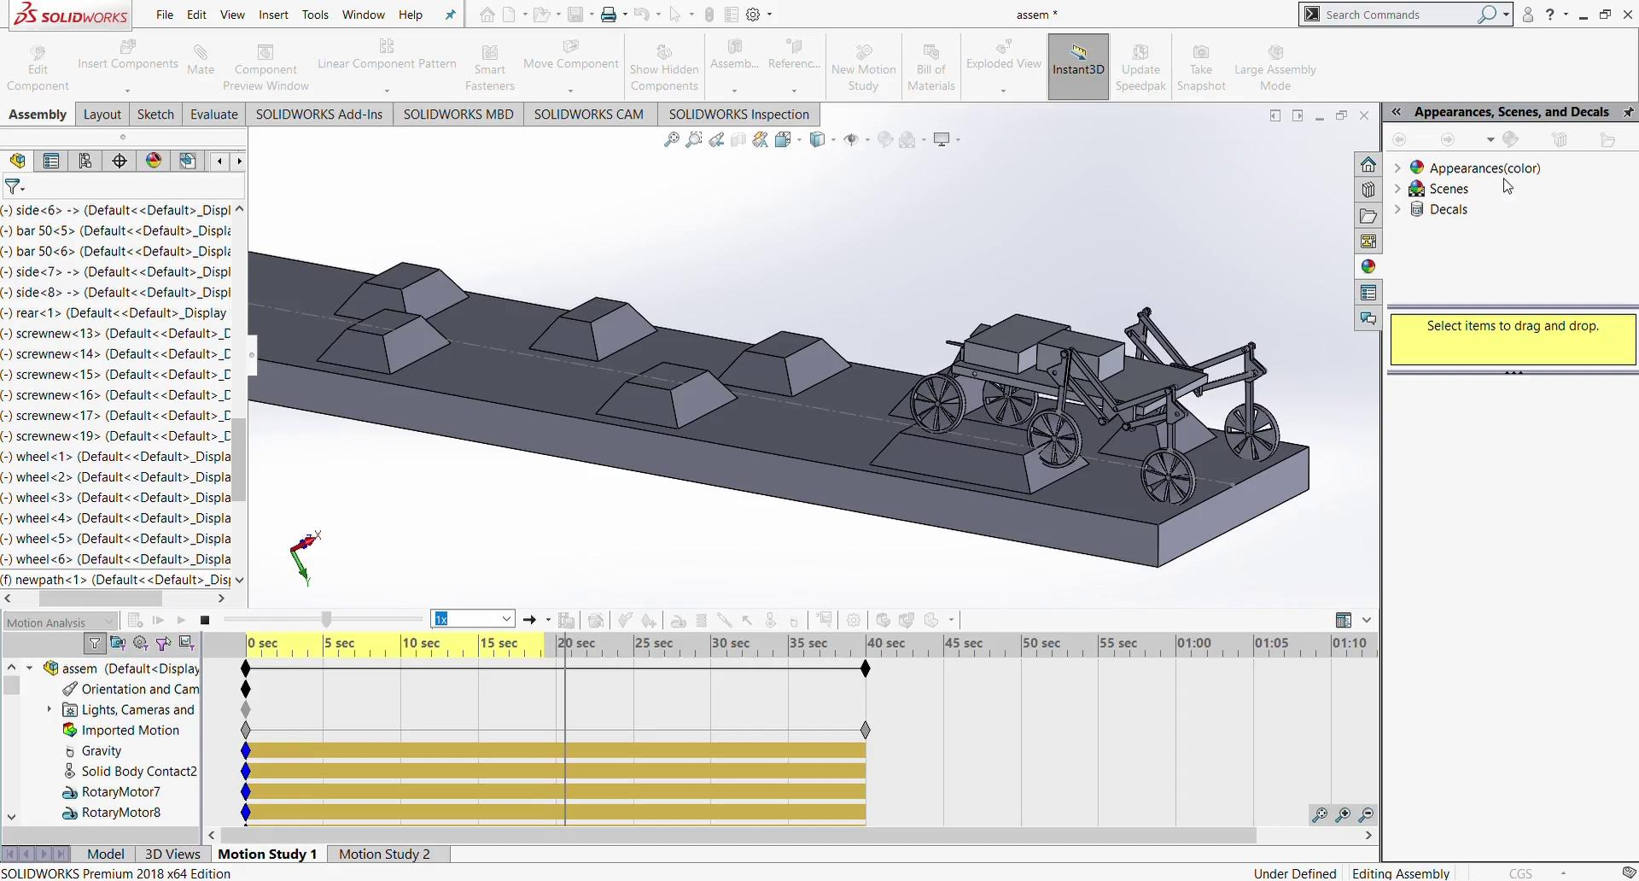
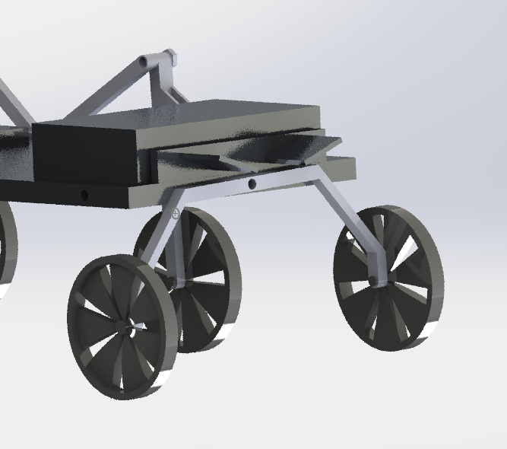
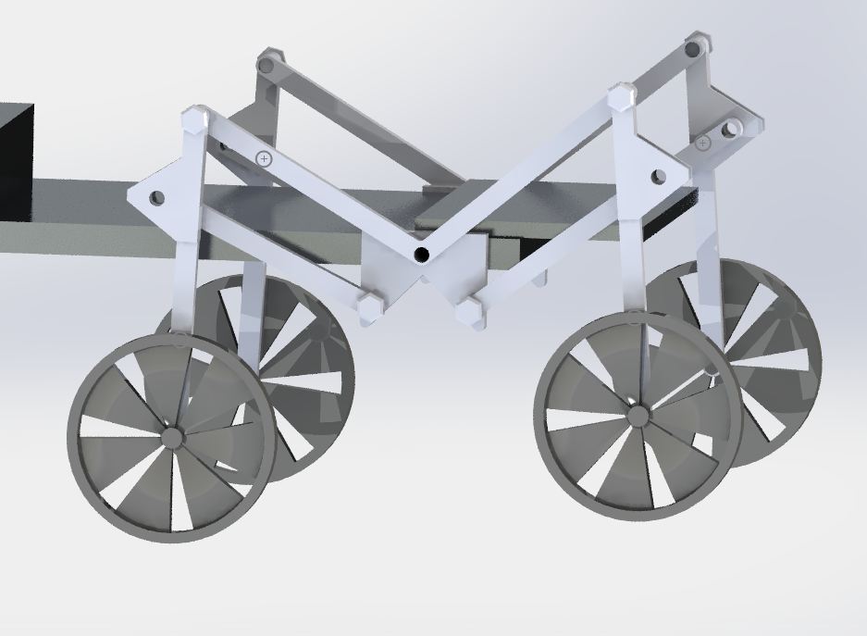
Subsystem - Mechanical ( chassis )
The Mantis Design
Key Features
Six wheel individual motor design
Balanced even weight distribution
distributes weight away from the lowest wheel
More robust and does not require telescopic or hydraulic suspensions
system promotes a gliding behavior
Pic credits : Aditya G

Slide 14
Subsystem - Mechanical ( chassis )
Materials
Mother rover and swarm rovers
Rover main body - Aluminium alloy 2219- O
Tensile Strength -170000000 N/m^2
high fracture toughness
Is weldable and resistant to stress corrosion cracking
Rover wheels - Aluminium alloy 2219
Stress intensive parts in the rover - Al alloys or Ti alloys
good strength to weight (Al)
low cost (Al)
High temperature and radiation (Ti)
High strength (Ti)

Slide 15
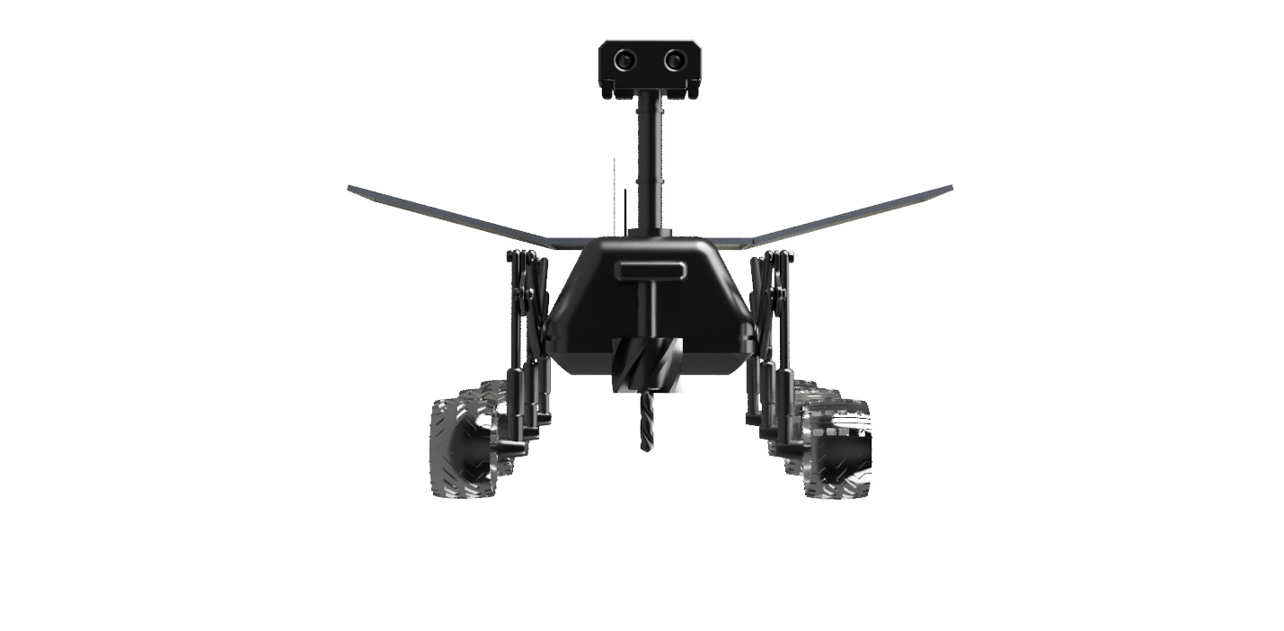
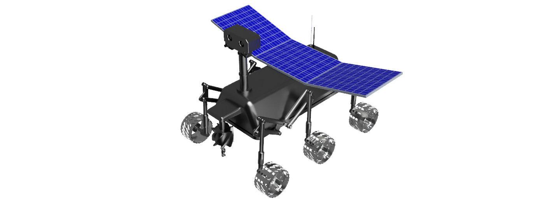
Subsystem - Mechanical ( chassis )
Mother Rover Design
Pic credits : Ashraf R and Aditya Pic credits : Ashraf R and Aditya
The large 6 wheel design paired with a large centre of gravity provides excellent control and stability over any terrain.
Dimensions of the mother rover - 1.5 * 1 * 1.2 metres
Weight of the rover - Approximately 750-850 kgs ( including onboard equipments )

Slide 16
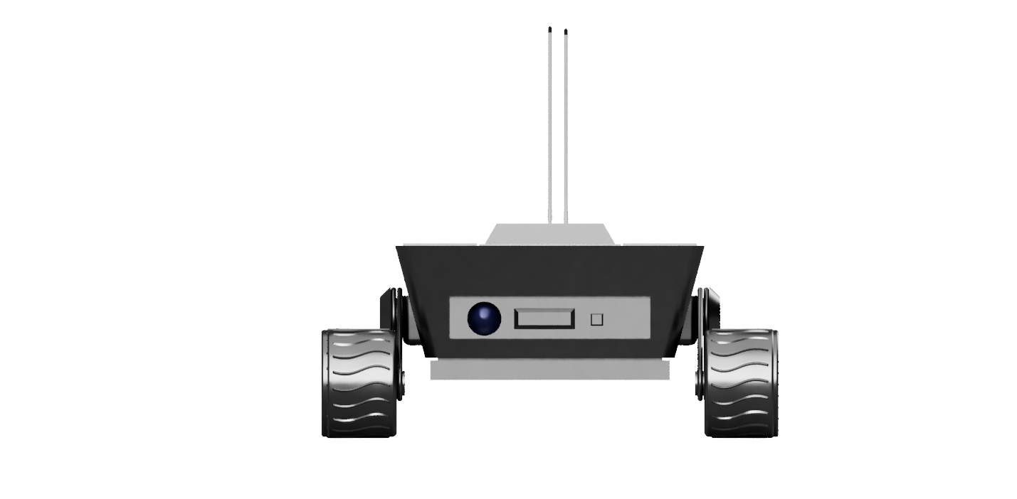
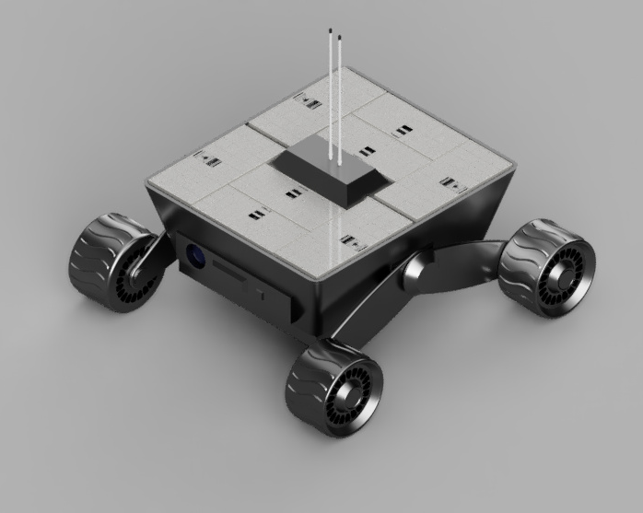
Subsystem - Mechanical ( chassis )
Swarm rovers
Pic credits : Ashraf R Pic credits : Ashraf R
Dimensions of the mini rover : 30 x 30 x 20 cm
Mass of the mini rover : Approximately 15-20 kg ( based on onboard electronics )

Slide 17

Subsystem - Mechanical ( chassis )
Swarm rover deployment
Video credits : Ashraf

Slide 18
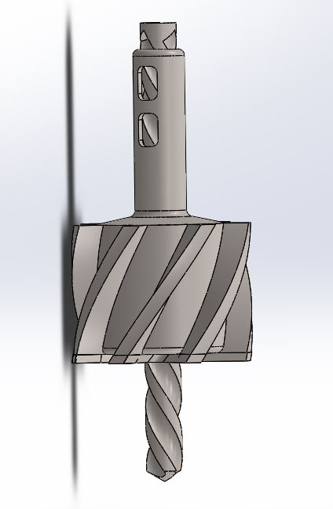
Subsystem - Mechanical ( Excavation )
Main Objective :
Basic principle: To excavate using drilling operation and collect the required sample in the collector
Principle steps to consider :
To perform drilling operation and collect the sample required at different depths .
Drilling
Flushing unwanted soil/regolith
Collection of required sample respective of the depth in a sample collector
Retraction of drill

Slide 19
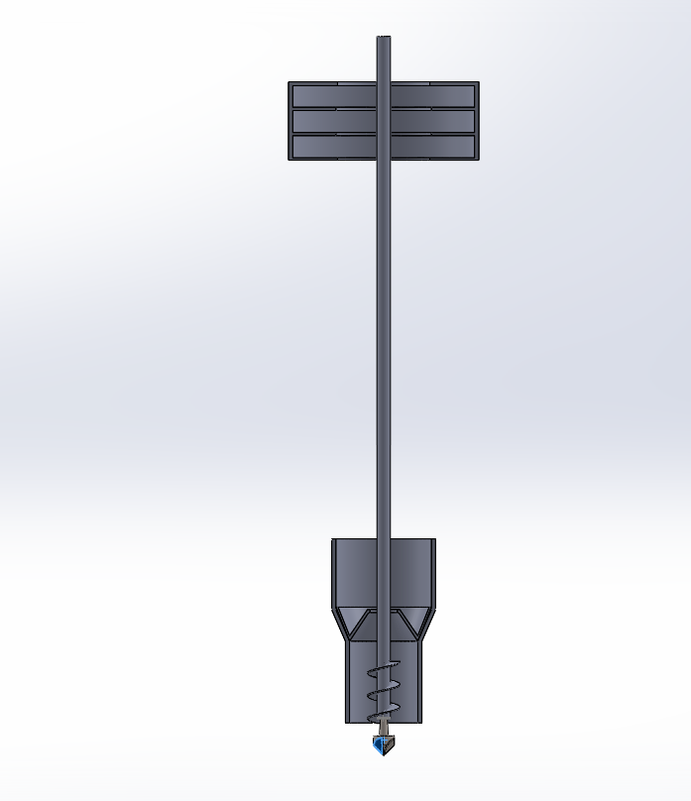
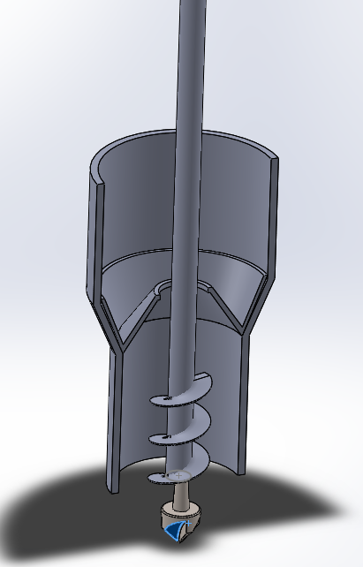
Subsystem - Mechanical ( Excavation )
Conceptual design :
Sample storage
Outer cylinder
+ Sample bucket

Slide 20
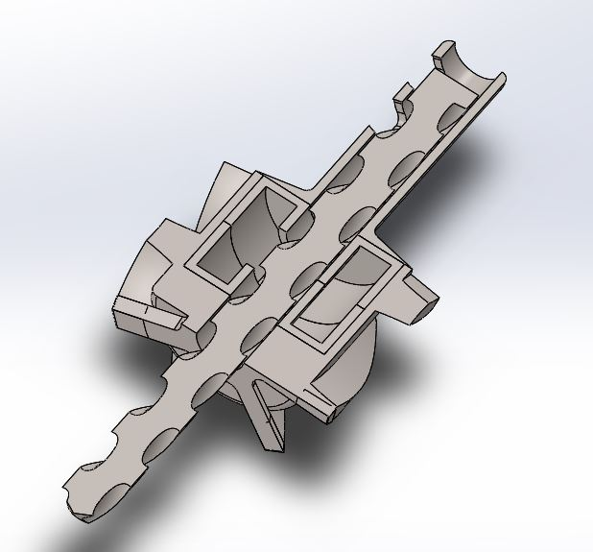
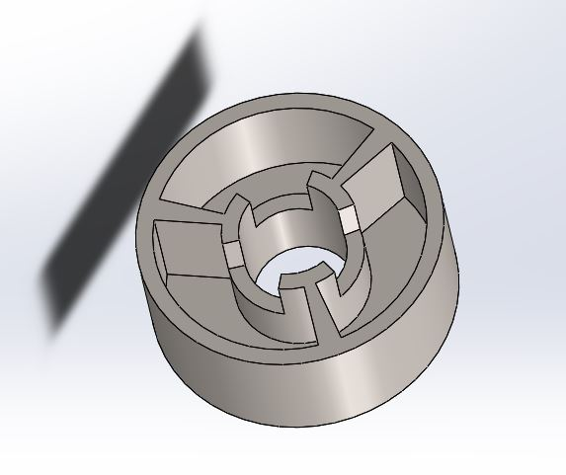
Subsystem - Mechanical (Excavation)
Sample collector with compartments
Optimization of the design :
Combining both sample collector and bucket

Slide 21
Subsystem - Mechanical (Excavation)
video credits : Aditya G

Slide 22
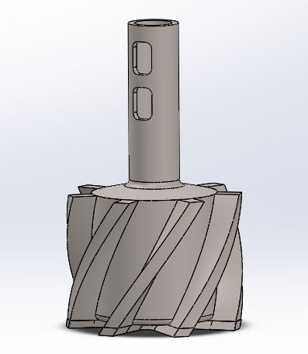
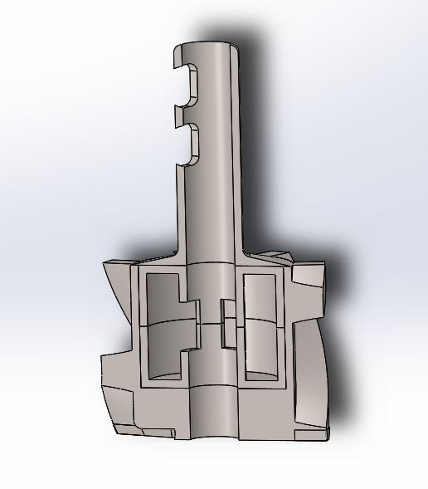
Subsystem - Mechanical (Excavation)
Slots to flush excess material
Sample collector with compartments
Inner drill
Working:

Slide 23
Subsystem - Mechanical ( Excavation )
Dimensions :
(Ref : These dimensions are based on the size constraints of the queen rover)
Weight : Gross(total) = 30 kg
Sample = 0.271 kg ( considering density of regolith soil = 1.5 g/cm^3)
 | Inner dia | Outer dia | Height
Inner drill | __ | 5.6 cm
Outer drill (counterbore part ) | 9 cm | 28 cm | 18 cm
Sample collector | 6 cm | 9 cm | 15 cm
Inner spool | __ | 5.6 cm | __
Outer spool | 6 cm | 8 cm | 300 cm

Slide 24
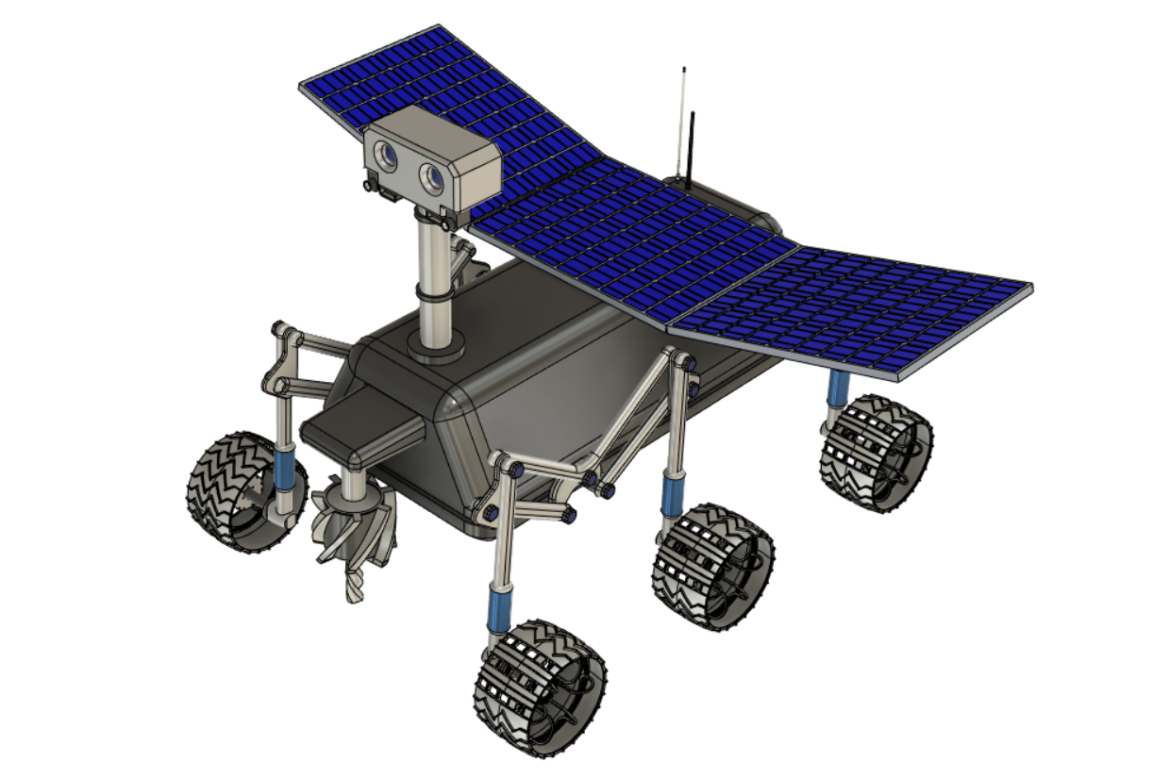
Subsystem - Mechanical (Excavation)
Material selection :
(Ref :The above materials have been chosen based on Apollo lunar surface drill (ALSD))
Location of the drill tool on the rover :
Drill bit - The drill bit is made up of hy-tuf steel and tips are of tungsten-carbide .
Drill stem - The drill stem is made up from titanium

Slide 25
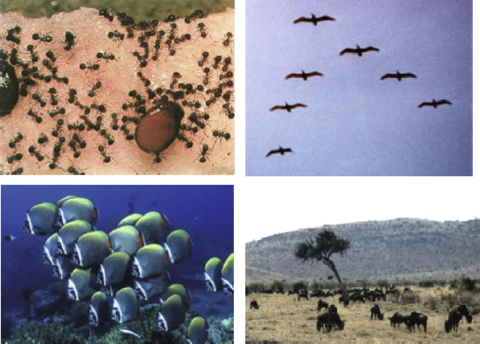
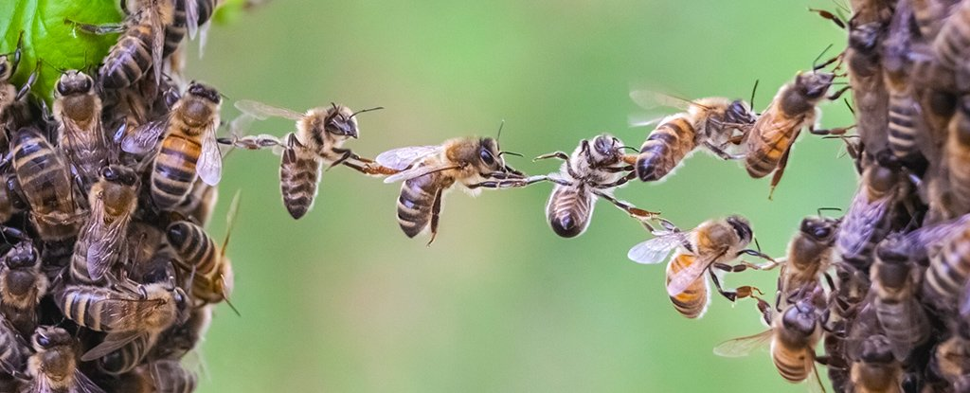
SWARM COMMUNICATION
The behaviour of the swarm rover defines how the bots should organise itself with respect to its local neighbours and the specified goal. The behaviour can be observed in nature like the ants forming a colony to perform difficult tasks or like the birds flocking to avoid getting lost during migration. Some basic spatial organisation are aggregation, dispersion, pattern formation, self assembly and clustering. Depending upon the application the behaviour is chosen and coded into the bots.
Picture source: Internet

Slide 26
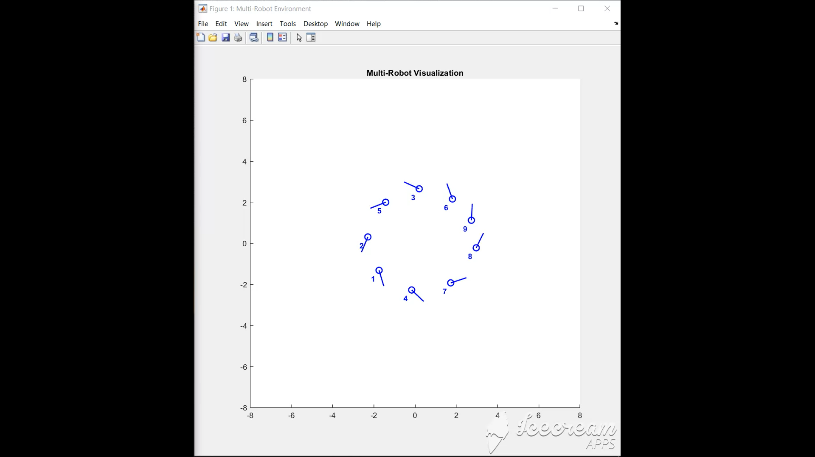
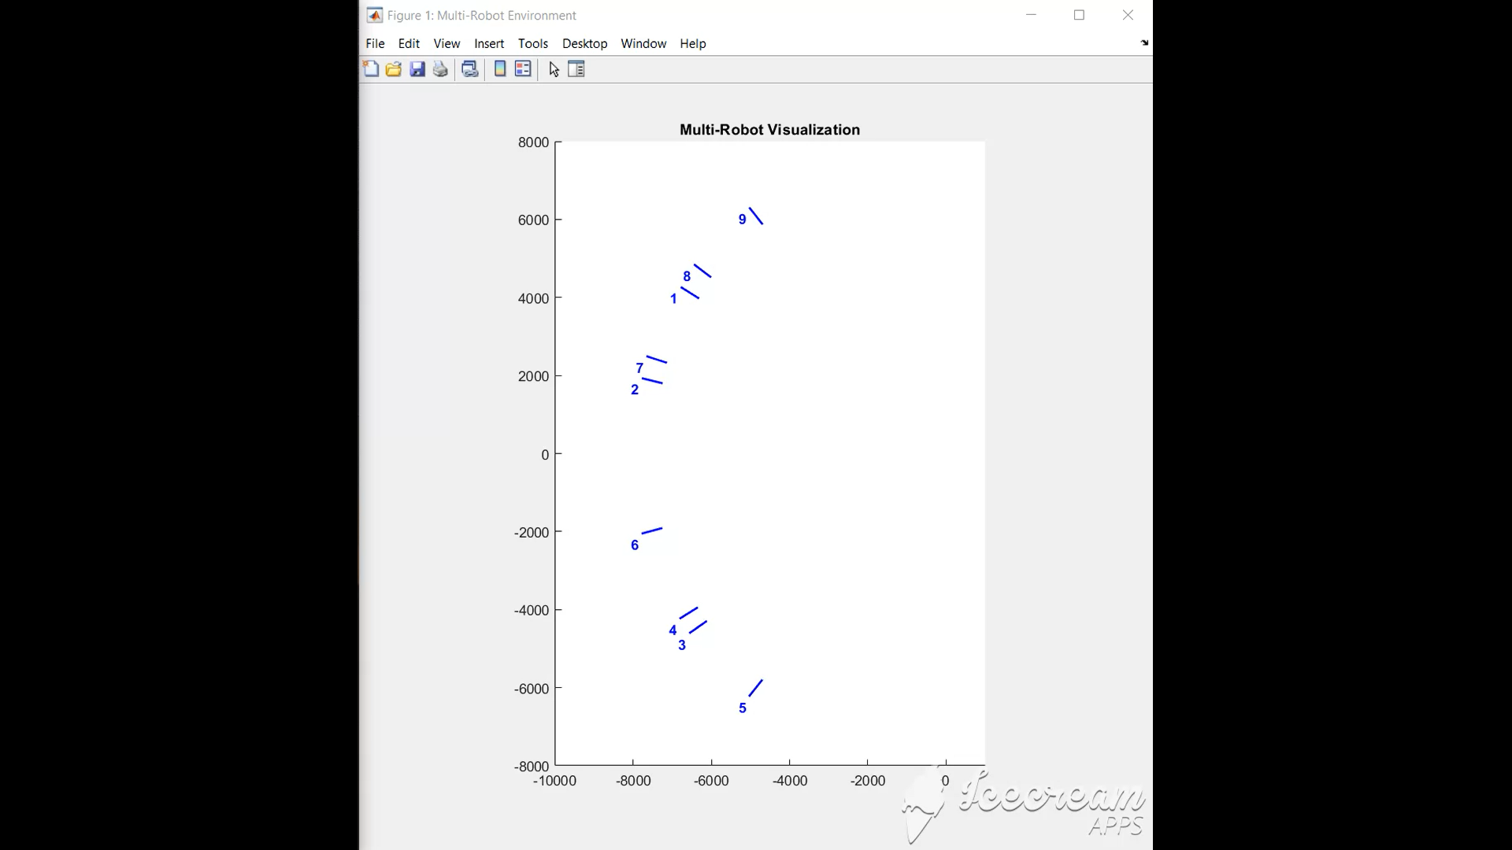
SWARM COMMUNICATION
Upon several studies the dispersion behaviour was chosen for implementation of swarm on the moon. This behaviour can maximise the exploration area at the moon. Among its advantages are concurrent execution of subtasks in task-decomposable application domains, robustness against system failure, scalability, flexibility in adapting to a different domain through reconfiguration, and cost effectiveness.
As you can see in the screenshots, the behavior was modelled in MATLAB using robotics toolbox.
Picture credits: Asvanth
Picture credits: Asvanth
Notes:
Upon several study the dispersion behavior was chosen for implementation of swarm on the moon. This behavior can maximize the exploration area at the moon. Among its advantages are concurrent execution of subtasks in task-decomposable application domains, robustness against system failure, scalability, flexibility in adapting to a different domain through reconfiguration, and cost effectiveness.
After the bots are dispatched from the rover, each bot travels away from the point of dispatch without colliding. As you can see in the screenshots, the behavior was modelled in MATLAB using robotics toolbox. Nine robots were initialized in the multiple robot environment with detectors. The environment was updated at regular time step. In each updation the position of the bots was changed such that it moved outward from the dispatch point. If any other bots were detected, the range and angle was estimated between the bot and its neighbors. The velocity and turn rate are updated depending upon the range and angle measured. The velocity with respect to the inertial frame is obtained, and discrete integration is performed to obtain the position and heading angle for each bot.

Slide 27
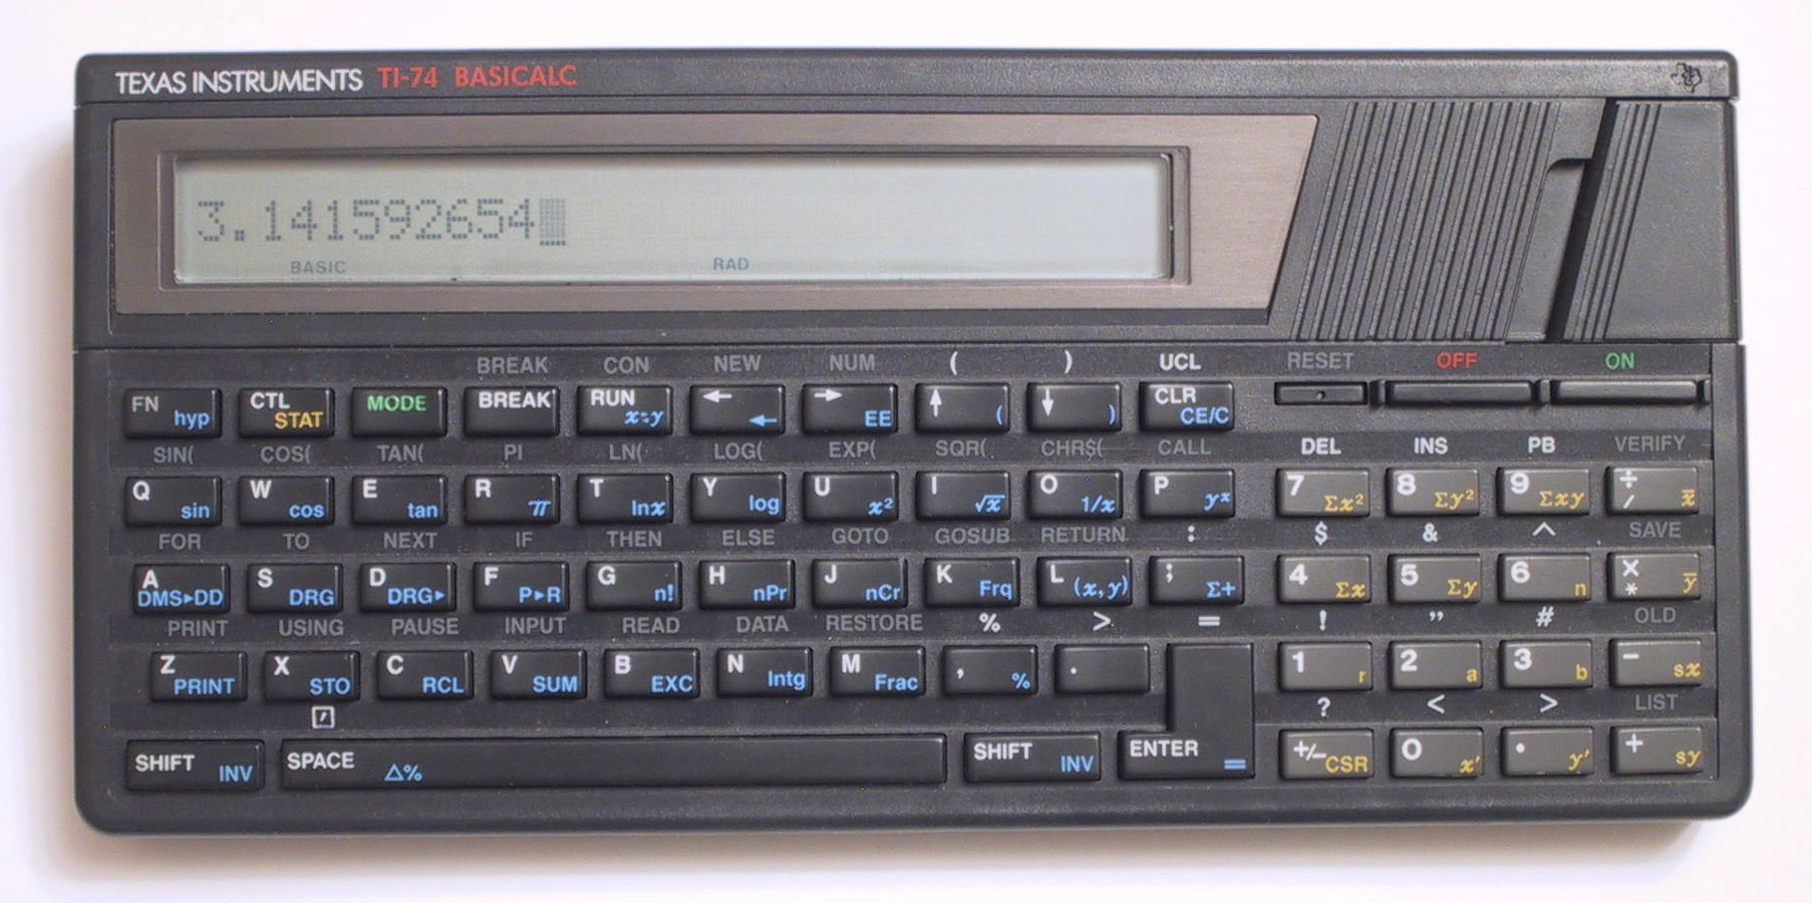
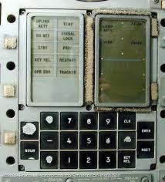
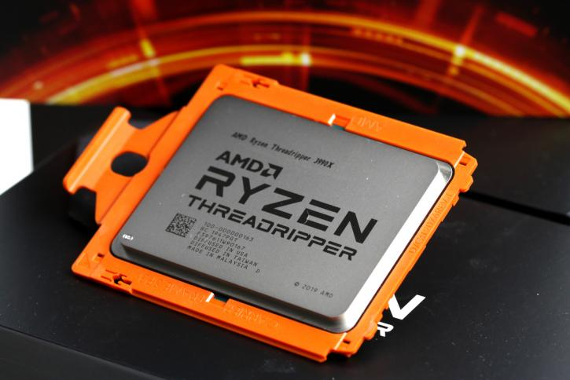
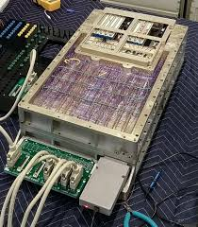
Subsystem - Compute Module
(>)^{1 Billion}
>>
Modern Day CPU
TI - 74
Saturn V and Apollo Computers
Source : Internet

Slide 28
Subsystem - Compute Module
Objective
To utilize the potential of today’s computing power to the lunar rovers to perform complex analysis and experiment on the moon which has been never done before.
Implementing autonomous navigation among the main rover and among the swarms.
Performing in-situ experiments like soil analysis and lunar rock analysis.
Why on-board computing?
A 1.25s time lag does not allow split second decisions to take place.
Rough terrain can be handled better if on board decision making takes place.
Reducing possible human errors by automating movements and actions.

Slide 29
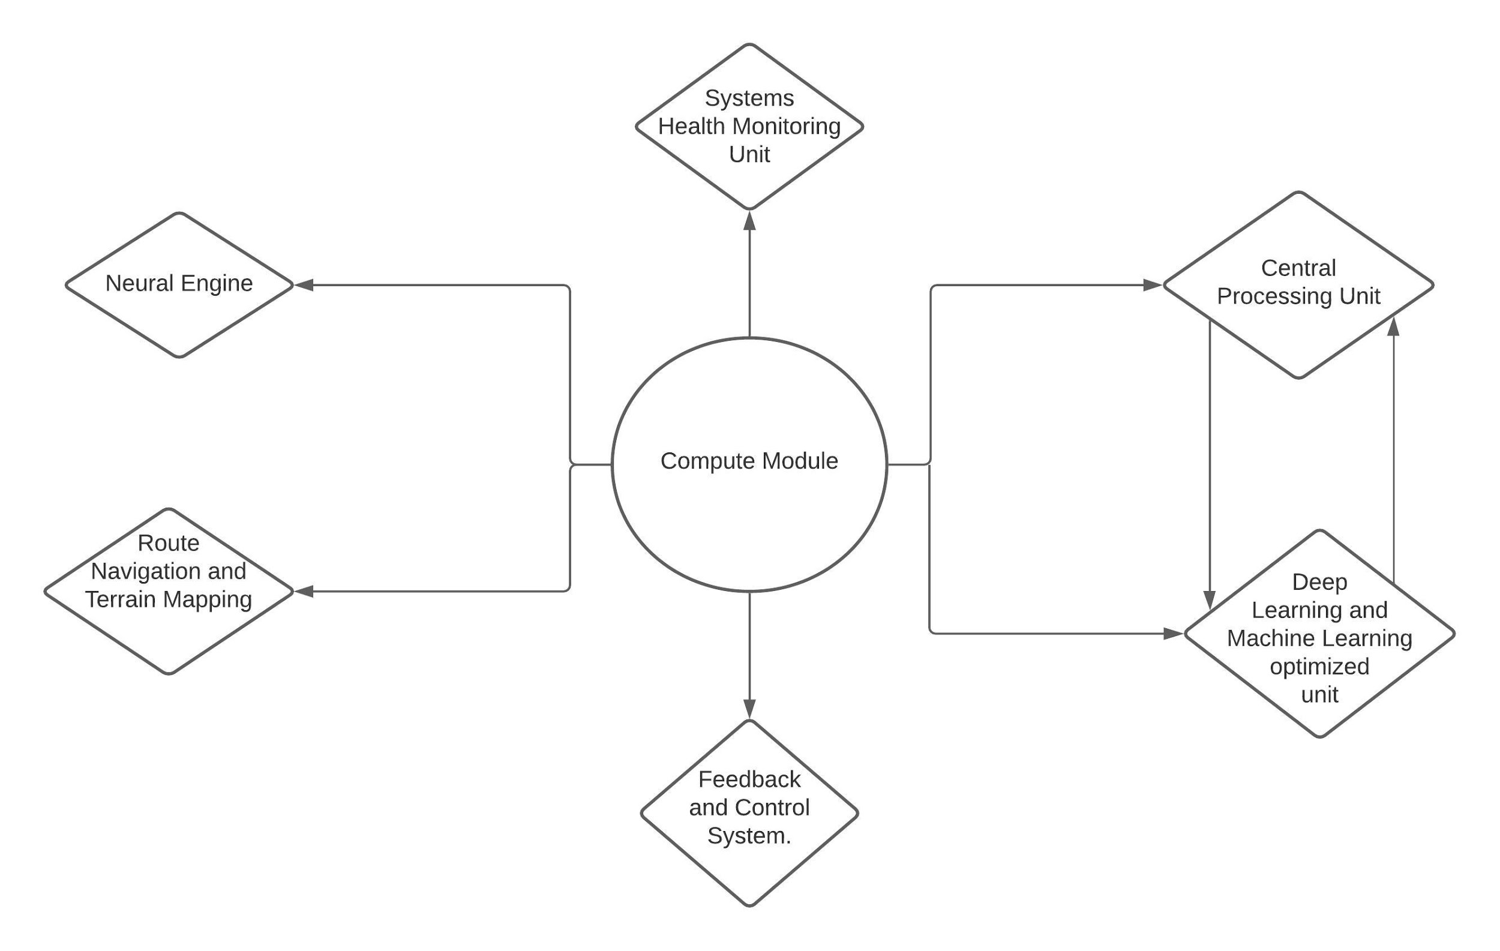
Subsystem - Compute Module

Slide 30
Subsystem - Compute Module
All our SoCs in the main as well as swarm rovers are radiation hardened.
Central Processing Unit
700 MHz primary CPU coupled with 400 MHz CPU for parallel processing
Above unit is paired with a 300 MHz CPU for redundancy.
For Main Rover: 4GB of flash memory paired with 512MB of DRAM of shared memory
For Swarm Rovers: 2GB of flash memory coupled with 256MB of DRAM of shared memory.
Smart Computing Unit
Smartly assigns tasks to all compute model components and to the swarm rovers.
Redirects power to components under load and shares processing load among various components.
Deep Learning and Machine Learning Unit
Has 250 MHz processing unit coupled with 1GB of RAM.
Optimised for Deep Learning and Machine Learning tasks for soil analysis.

Slide 31
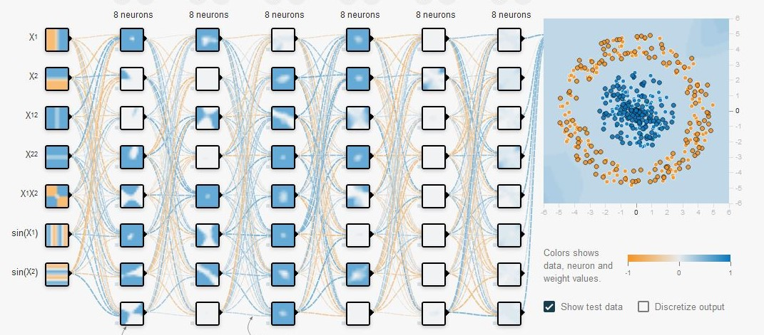
Subsystem - Compute Module
The size of the activation layer is 336.
Credits : Srinivas and Siddhaanth

Slide 32
Subsystem - Compute Module
Neural Engine
Responsible for improving image and video quality of the rovers.
Also responsible to increase efficiency of soil analysis.
System Health Monitoring Unit
Monitors the health of the rover under periodic time intervals.
Checks status of all rover components and instruments.
Performs a continuous chain of rigorous tests for each and every component.
Feedback and Control System
Works with the Health Monitoring Unit to analyse results and correct any malfunctioning systems.
Unit will be running in continuous loops under various arguments for getting optimized results - a feedback loop.

Slide 33
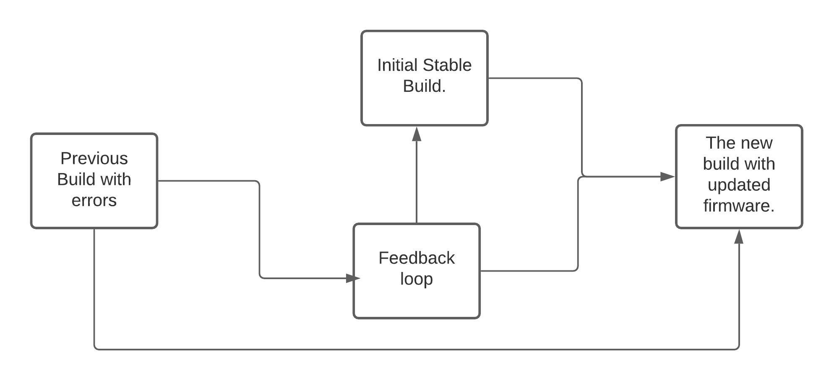
Subsystem - Compute Module
Feedback and Systems Health Monitoring Unit.
Credits : Srinivas and Siddhaanth

Slide 34
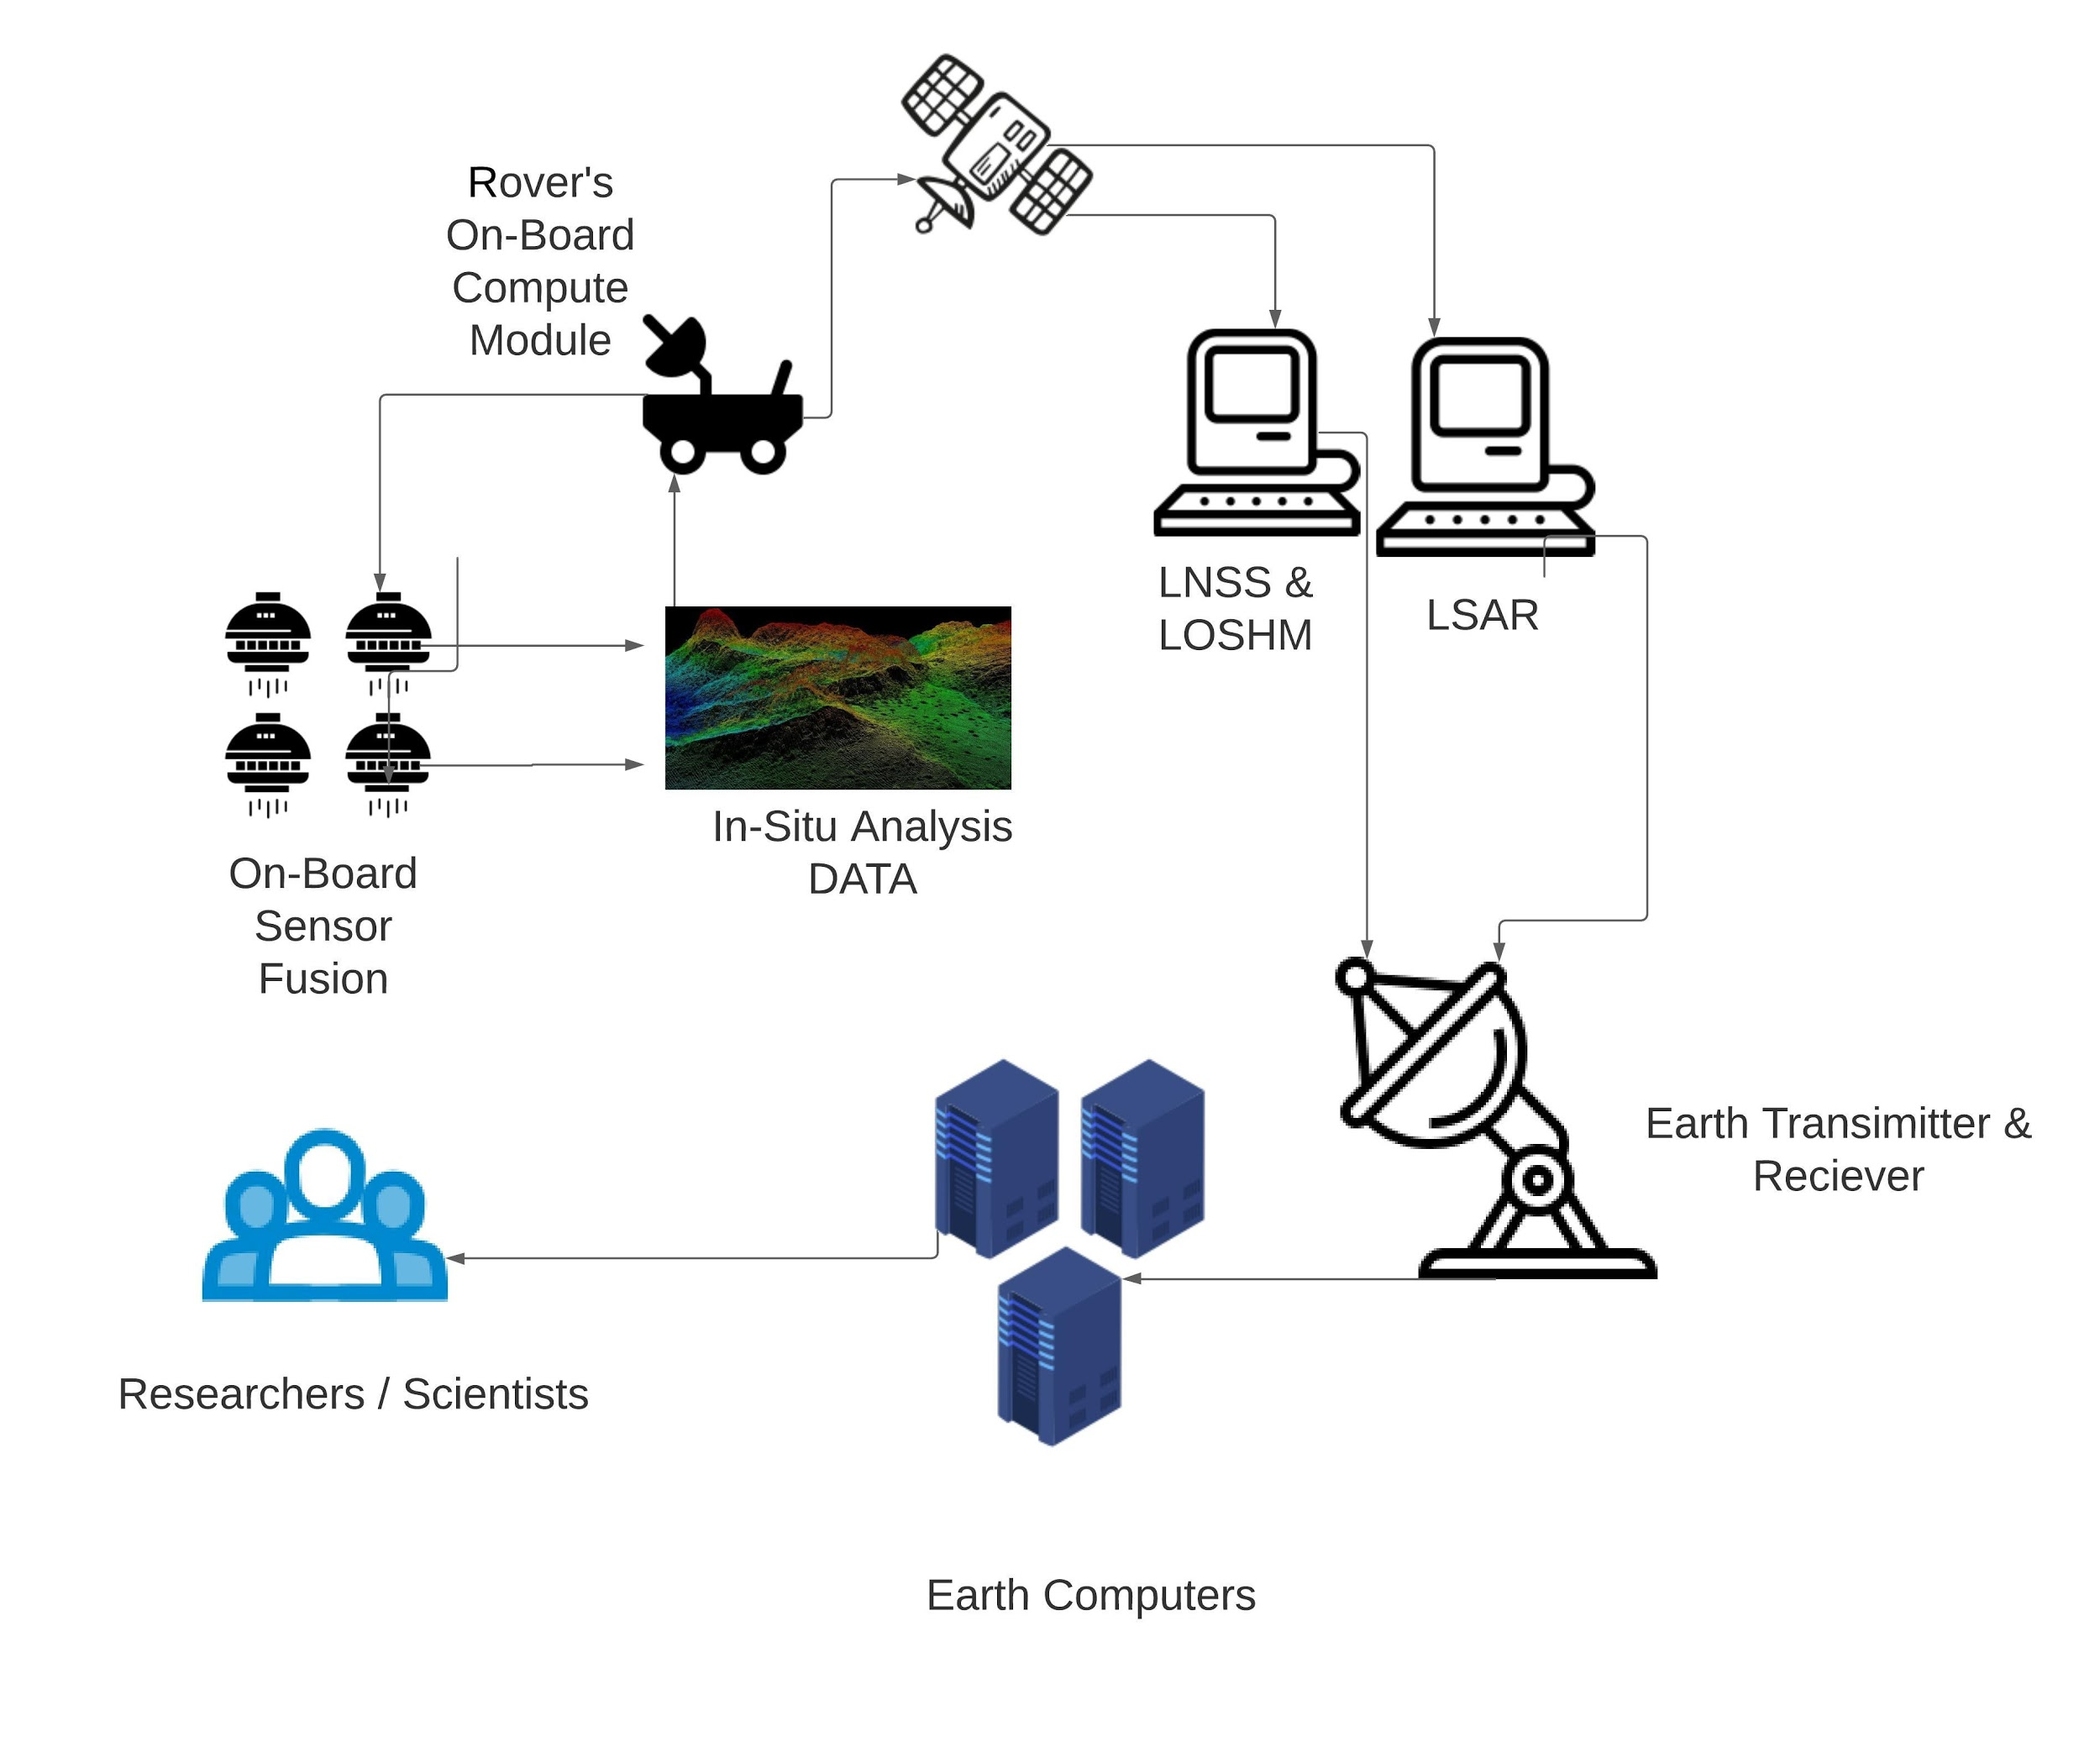
Subsystem - Compute Module
Working of the Rovers
SAR - Synthetic Aperture Radar
LNSS - Lunar Navigation Satellite System
LOSHM - Lunar Observation for Structural Health Monitoring System
Credits: Srinivas and Siddhaanth

Slide 35
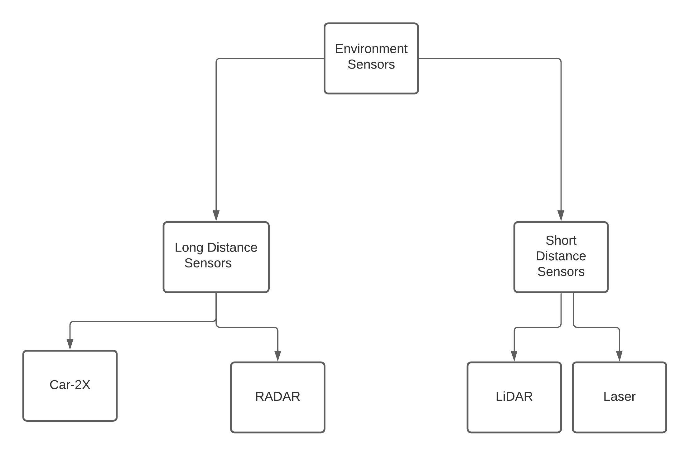
Subsystem - Compute Module
Autonomous Navigation and Terrain Mapping Unit.

Slide 36
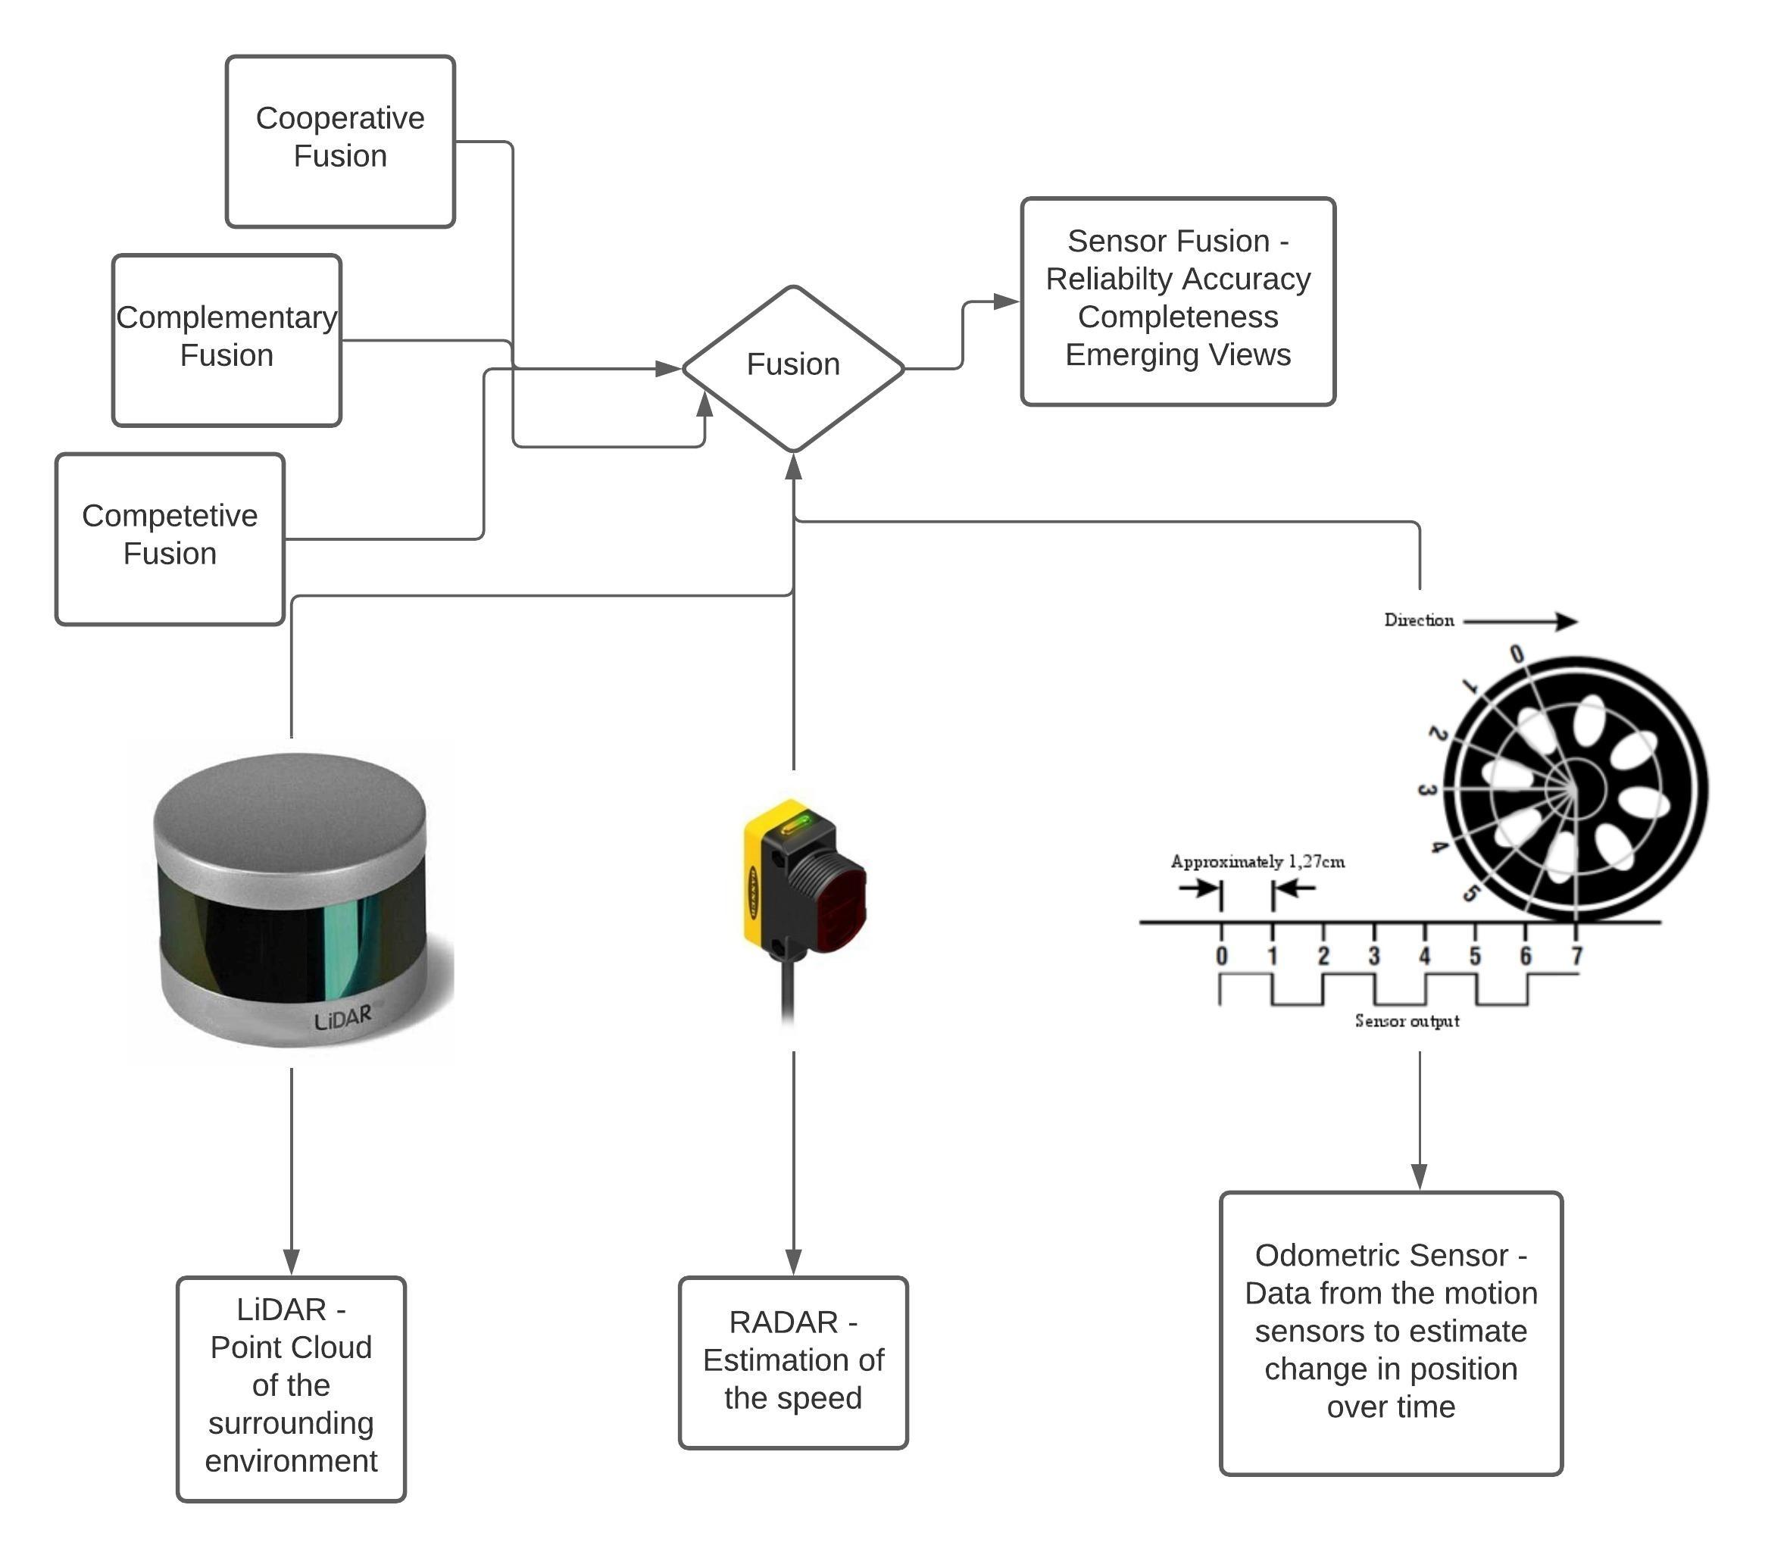
Subsystem - Compute Module
Sensor Fusion
Credits : Srinivas and Siddhaanth

Slide 37
Subsystem - Communication (WPT)
OBJECTIVE
To supply power to the swarm rover mechanism on the lunar surface wirelessly from a cube satellite.
BASIC PRINCIPLE OF WPT
Power transmission through electromagnetic wave propagation.
Two categories based on range of transmission
Near/Reactive field
Far/Radiative field (if R ≥ 2L² / 𝝀)
Power beaming technique using microwave and laser.
Power and efficiency calculation using Friis equation,
P_{R} = λ²G_{R}G_{T} / (4πD)² = A_{R}A_{T}P_{T} / (λD)²
η = 1 - e^{-(τ^2)} where, τ² = A_{T}A_{R} / (λD)²

Slide 38
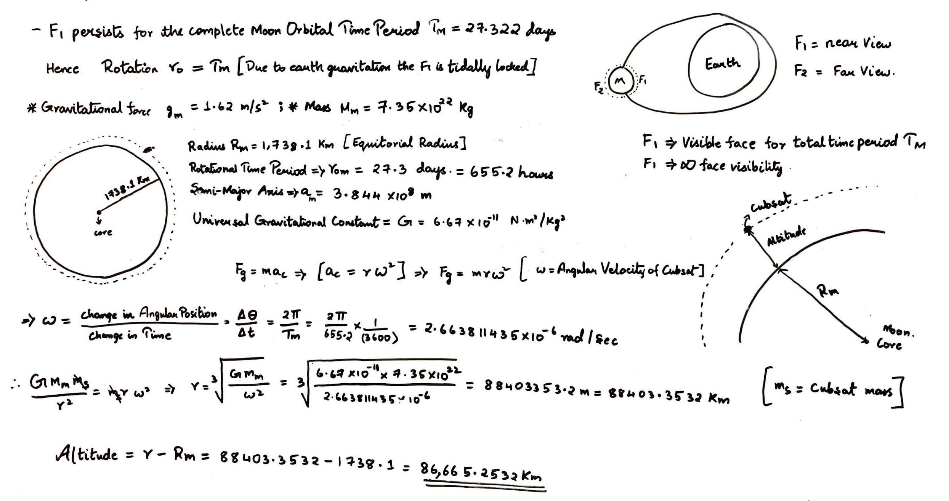
Subsystem - Communication (WPT)
Cube Satellite Orbital Calculation:

Slide 39
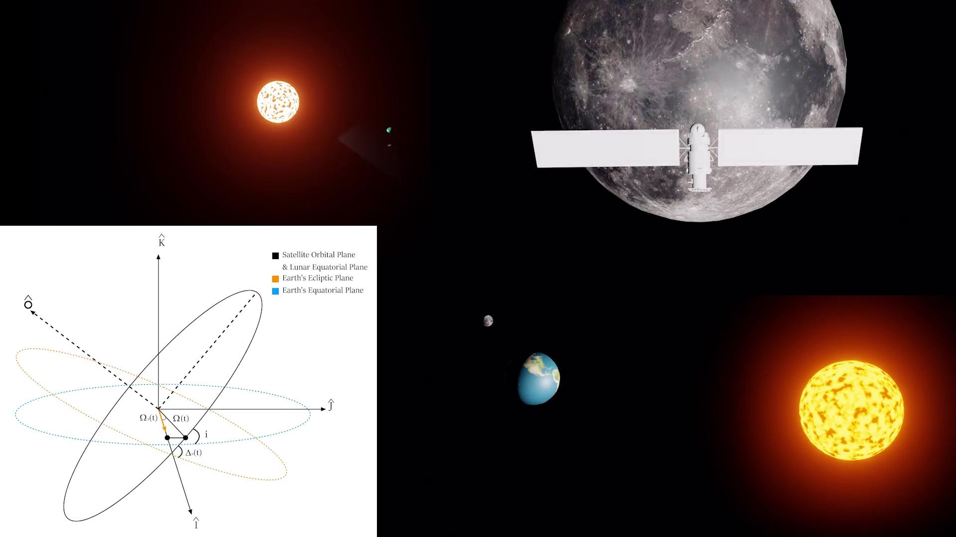
Subsystem - Communication (WPT)
Cube Satellite 3D Simulation:

Slide 40

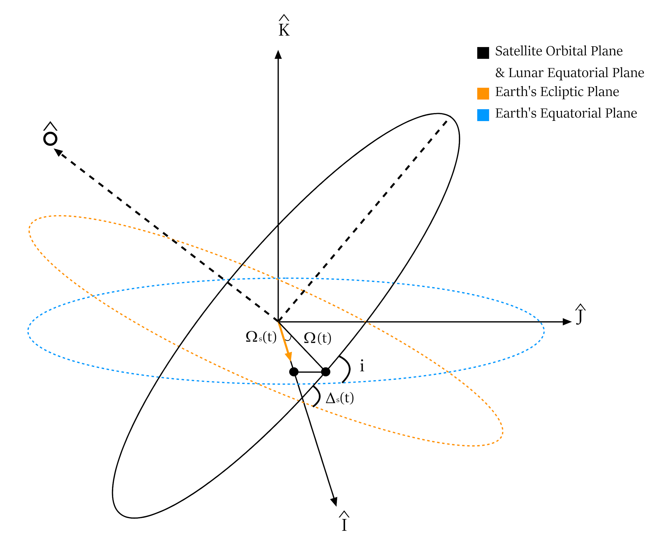
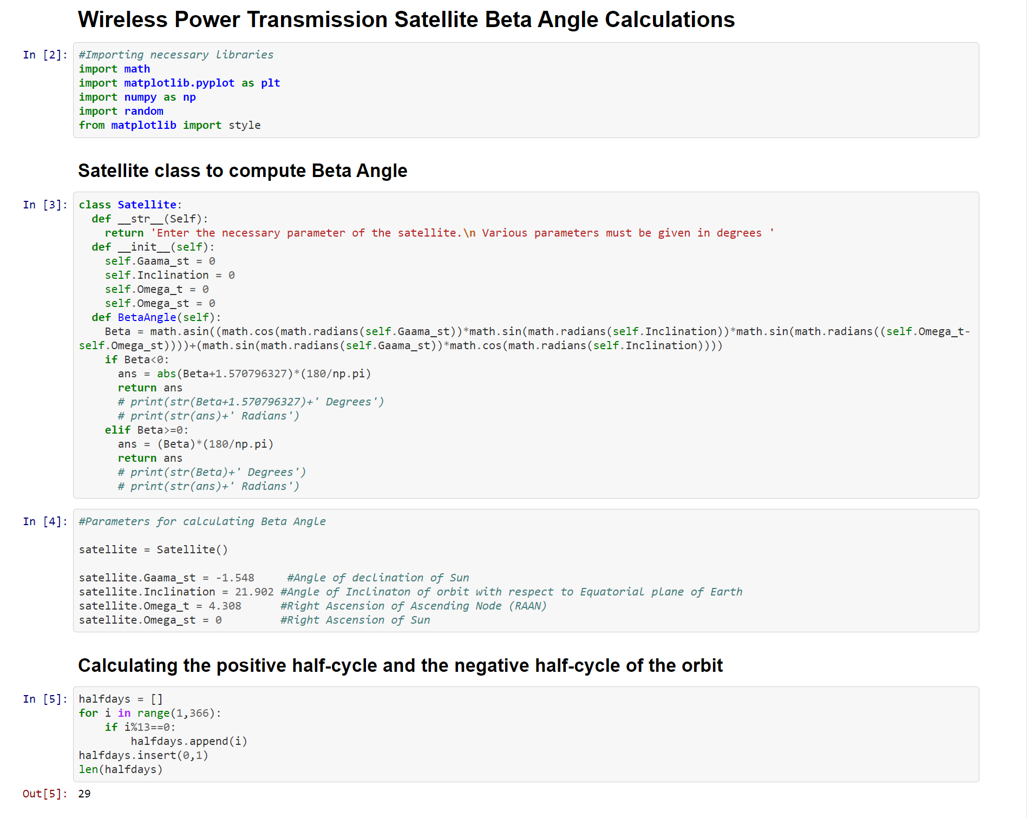

Subsystem - Communication (WPT)
Cube Satellite Beta Angle Calculations:
GitHub Repo

Slide 41

Subsystem - Communication (WPT)
FUNDAMENTAL CONSTRAINTS
Transparency of the atmosphere to the used wavelength
Possibility for directional emission
Possibility to convert the energy from the form of its source (solar, electric, heat) to a transmittable form (e.g. microwave, laser, acoustic)
Possibility to convert the transmittable energy form back into a useful form of energy (e.g. electricity, hydrogen).
LPT(Laser Power Transmission)
High intensity laser power beam for directional transmission with smaller aperture.
Conversion using photovoltaic cells (Si) at the receiving end.

Slide 42
Subsystem - Communication (WPT)
LIMITATIONS
This is a budding mechanism which needs a lot of research and development to achieve required goals
Excavation Equipment needs extra power in addition to the power for basic functions of the rover.
FUTURE SCOPE
Important field of research
Sustainable source of energy
SBSP (Space Based solar power), UAVs (Unmanned aerial vehicles), Household power distribution, etc.

Slide 43

Future Prospects
Setting up a 3D printing hub for building.
Extracting water ice from the lunar surface.
Using said water ice for growing plants, extracting hydrogen for rocket fuel and oxygen for breathing.
Extracting useful minerals and elements to build a thriving ‘CHAAND City’.
Source: Internet

Slide 44
Vote of Thanks
A huge vote of thanks to the administration team of SSERD who gave us the opportunity to come together as a team and work for a period of forty one days.
Thank you for all the assistance especially Pavan Kumar who was ready to mentor us whenever we needed guidance and Prateek Boga who was an amazing coordinator.

